Slide 1

Temporary Food Service Vendors
Cleveland County Health Department
(980) 484-5130

Slide 2
What is a temporary food event?
(TFE)
Operates No more than 30 days in one location per calendar year.
Affiliated with and endorsed by a transitory fair, carnival, circus, festival, or public exhibition
“Domestic yard sales and businesses such as auctions, flea markets, or farmers' markets are not eligible for a TEMPORARY FOOD ESTABLISHMENT PERMIT.”
Event must be in accordance with State Definition!

Slide 3
Application Process
Application must be submitted no less than Fifteen days prior to the event!
$75 permit fee required per booth, unless exempted (check or credit card accepted)
Fees collected at the Cleveland County Permits Office at 1333 Fallston Road, Shelby, NC 28150, or mailed in advance to 200 South Post Road, Shelby, NC 28152 (980-484-5130)
“This 15-day requirement does not prohibit the submission of applications for substitute vendors provided that these applications are submitted no fewer than 3 business days prior to the event.”

Slide 4
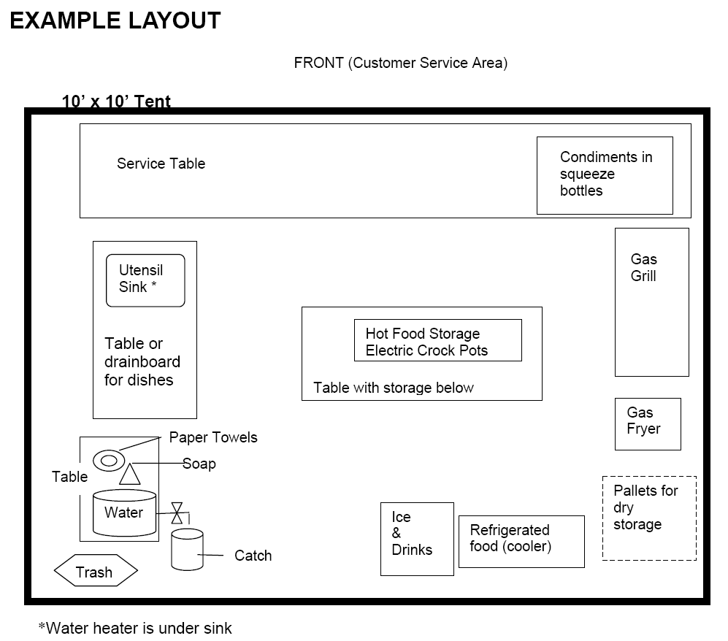
Application Continued
Diagram of booth setup and menu required:

Slide 5
Exemptions
After submitting application, the following groups may be exempted by the health department from obtaining a TFE permit, depending upon the length of event:
Groups only selling Non-Potentially hazardous foods.
  Example: popcorn, candied apples, cotton candy, etc.
Nonprofit organizations
Political fundraising committees
Elderly nutrition programs

Slide 6
Food Safety!
All foods shall be clean, wholesome, free from adulteration, and from an approved source.
Pre-pattied or ready to cook portions of meats must be purchased, unless prior approval pending equipment and prep areas.
No cooking and cooling of foods for subsequent days use is allowed, unless approval is granted during permitting.
Potentially hazardous foods from previous events may not be used if removed from original packaging.

Slide 7
Food protection
Foods and food contact surfaces must be protected from contamination with use of food shields or barriers.
  Sneeze shields, stored off ground, covered
  Additional overhead protection required for food, utensils, equipment, dishwashing areas , and cooking equipment when individual servings including corn in the shuck. Exceptions include bulk foods such as roast, shoulder and briskets.

Slide 8
Food protection
Public access is limited to dining areas only, and storage units must be blocked from public access.
Produce washing requires an additional food prep sink.
Foods must be secured to protect from tampering and contamination.
Label and store toxic materials to prevent the contamination of food and equipment.

Slide 9
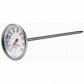
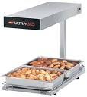
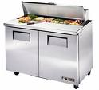
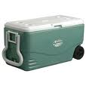
Food safety! Continued
Provide an accurate product thermometer.
Keep hot foods at or above 135 degrees
  Grills, warming cabinets, ovens, chafing dishes, steam tables, etc.
Keep cold foods at or below 41 degrees
  Refrigeration provided.
  Washable Coolers in good condition with drainage ports.

Slide 10
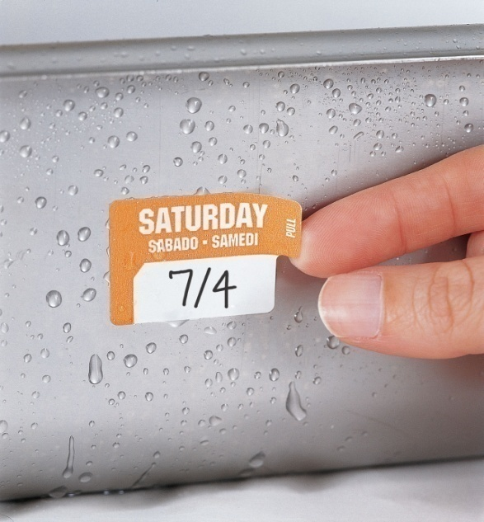

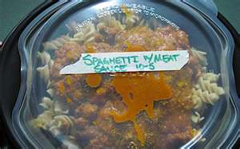
Date Marking
Food code regulation
  Required for food held more than 24 hours
Date mark any ready to eat product that has been opened from the original commercial packaging
Date can be marked on the day of opening or discard date

Slide 11

Employee Hygiene
Hair restraints
Clean outer clothing/aprons.
No sick people preparing food
  Employee Health Policy required

Slide 12


Good hygienic Practices
Wash hands frequently
  Before starting work, after each visit to the toilet, prior to donning gloves and as often as needed to prevent contamination
NO BARE HAND CONTACT WITH READY TO EAT FOOD
  Use tongs or gloves
  “Magic Hands”
    Gloves can be a vehicle for cross contamination
    Change gloves often

Slide 13




Good Hygienic Practices cont.
No tobacco use in food prep area
Employee Beverages
  Covered, consumed in sanitary manner, and properly located

Slide 14

No Bare Hand Contact With Ready To Eat Foods
1 ml of feces contain approx 1,000,000,000,000 viral particles
Proper hand washing removes 10,000,000,000
1,000,000,000 virus particles left on un gloved hands
1 -10 virus particles can make a person sick
FDA Food Code Presentation, 2011

Slide 15
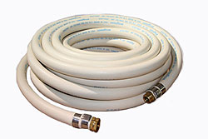

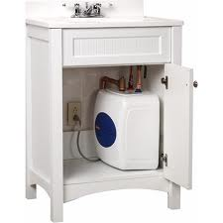
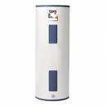
Provisions for Water
Approved Source: municipal or bottled
Under Pressure
Provisions for heating water
Use potable water supply hose if connecting to water source
Potable water tanks must be washed, rinsed, and sanitized, labeled for their purpose, and protected from contamination.

Slide 16
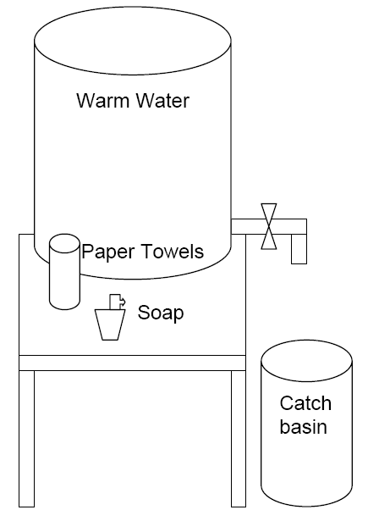
Handwashing Facilities
Must include at least 2 Gallon container with unassisted free flowing faucet
Warm water
Wastewater receptacle
Soap
Single use paper towels

Slide 17
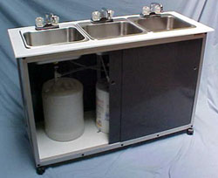
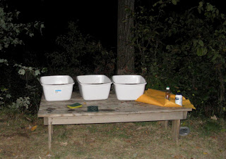
Utensil Washing
Three Basins are required for wash, rinse, and sanitizing. Need to be large enough to submerge the largest utensils, pots and pans accessible.
At least one drainboard or counter top space must be provided.
Provide approved sanitizer
No longer accepting a minimum of 1 basin sink.

Slide 18

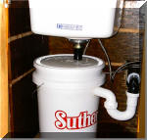

Sewage disposal
Approved Manner
  Municipal sewer
  Portable sewage disposal large enough to accommodate proposed use
  Wastewater collection containers must be as large as the potable water containers.
  If connected to hose municipal bib a connection to sewer is required
  Grease and water shall not be poured on top of ground or in storm drains!
  Conveniently located toilet facilities for employees

Slide 19



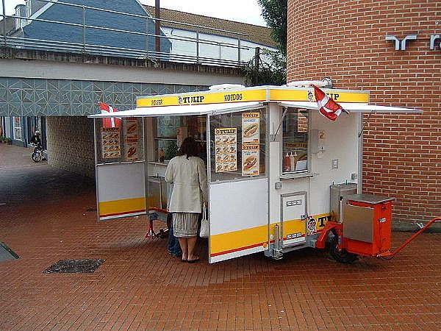
Premises
Surroundings shall be clean and sanitary
Arrange food, utensils, and equipment to minimize exposure to insect, dust, and other contamination
Provide screening or fly fans
In the absence of grass concrete or asphalt Indoor/outdoor carpeting, matting tarps, or similar non absorbent material must be provided
Garbage handled in a sanitary manner
Lights must be shielded or shatterproof bulbs, and lights are required for nighttime operation

Slide 20
Questions ?

Slide 21
Contact information
  Nathan McNeilly, REHS, Director
    Email: nathan.mcneilly@clevelandcountync.gov
    Phone: 980-484-5137
  Michelle Ford, REHS, EH Programs Coordinator
    Email: Michelle.Ford@clevelandcountync.gov
    Phone: 980-484-5272
  Darin Melton, REHS
    Email: Darin.Melton@clevelandcountync.gov
    Phone: 980-484-5144
  Tyler Ashe, REHS
    Email: Tyler.Ashe@clevelandcountync.gov
    Phone: 980-484-5132

